Slide 1
Soil P
The chemistry
&
The plant response

Slide 2
Wheat response to soluble P

Slide 4
[P] in solution (y axis)
Temperate agric plants ‘desire’ 3-10 µM P
They perceive ≤ 1 µM P in unfertilised soil
Therefore we add soluble P sources to meet the needs of early plant growth

Slide 6
P Budget (x axis)
P in the bank and in assets i.e. there are degrees of availability
It ‘buffers’ the cash supply (y axis) and meets P needs later in the season (when the fertiliser has dissolved)

Slide 7
How we store energy
Muscle glycogen
Liver glycogen
Fat

Slide 8
Shot putter, marathoner

Slide 9
How plants access P
Muscle glycogen soluble P
Liver glycogen fresh residues & surface adsorbed
Fat humus, soil minerals

Slide 10
Soil tests
Mineral P  adsorbed  soluble P
Insoluble organic  soluble P
(humus..fresh residues...LMWO’s, Ortho)
Colwell:
Olsen, Bray, Lactate:
0.01 M CaCl₂ :

Slide 11



Making Better Fertiliser Decisions for Cropping Systems in Australia
NSW Department of Primary Industries │ Private Bag 4008, Narellan, NSW 2567, Australia │ T + 61 4 2864 7787 │W www.bfdc.com.au

Slide 12
What is the database?
A repository of all available and scientifically valid N, P, K and S response trials for cereal, oilseed & pulse crop species (public and commercial trials)
Accessible online to registered users through the BFDC Interrogator tool
Tool used to derive soil test interpretation criteria

Slide 13
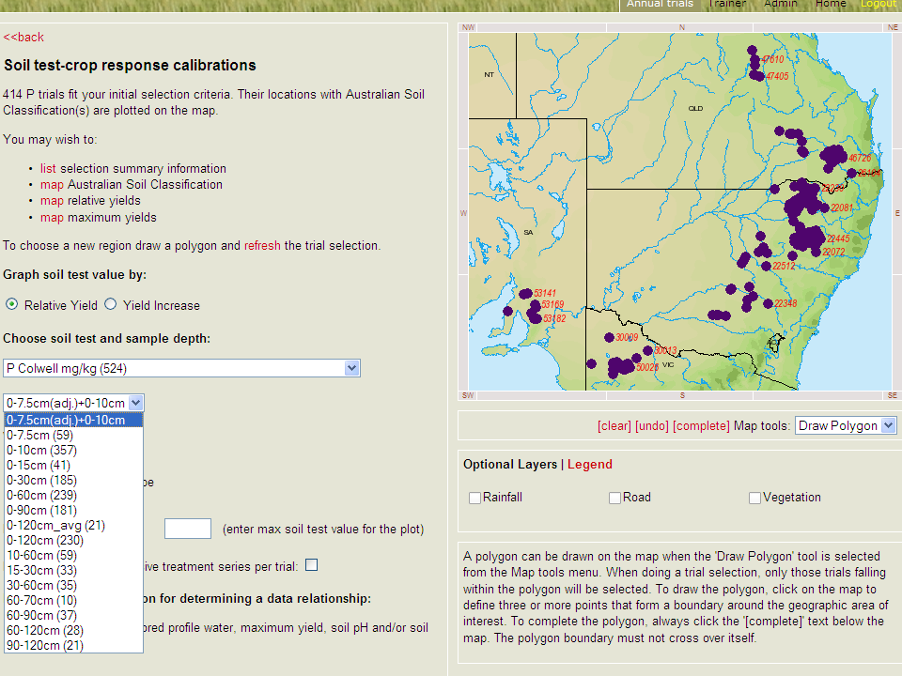

Slide 14
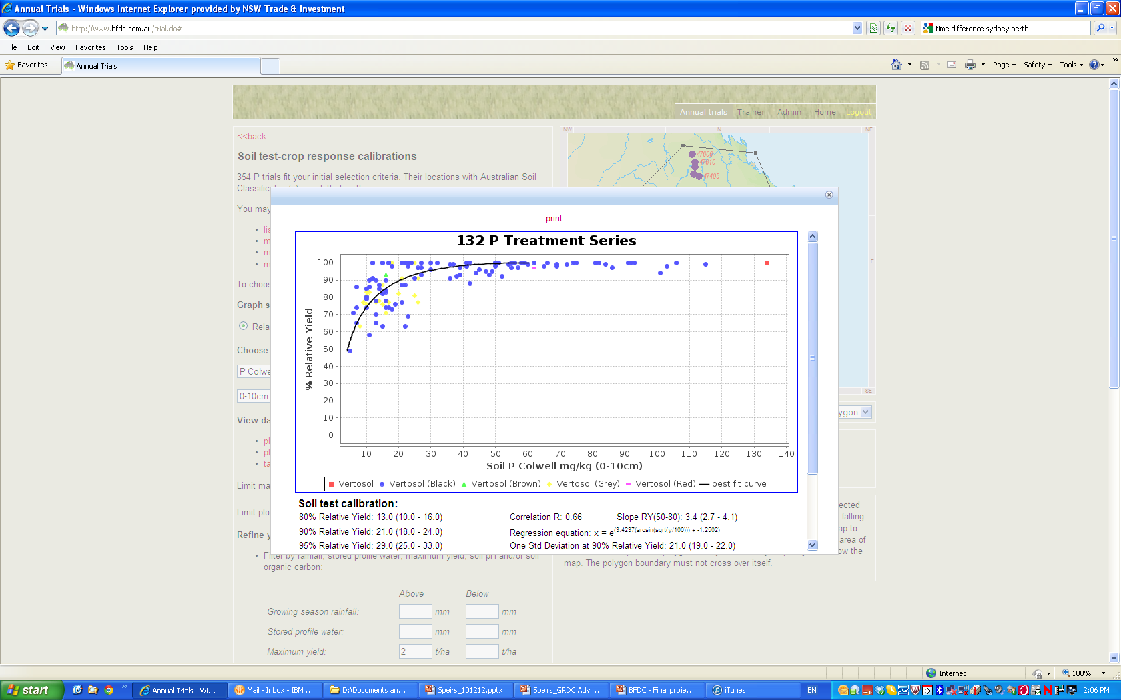

Slide 15
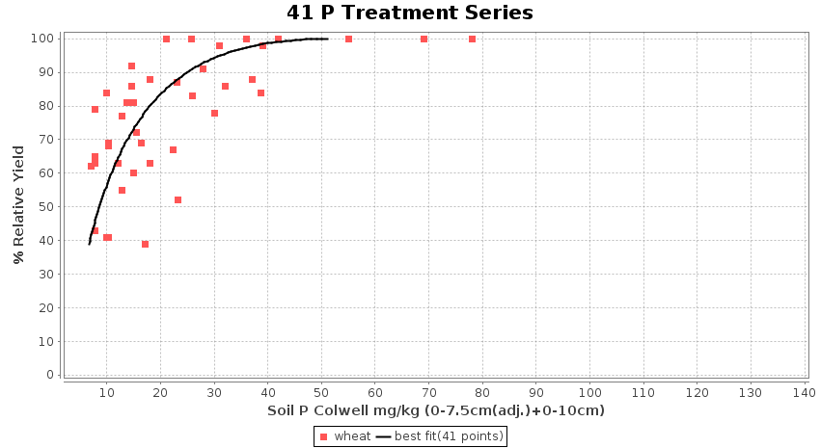

Slide 16
